Slide 1
Health Care Analysis

Slide 2
Group members
Mr.Syed Zubair Ahemad
Mr.Alessandro Elena
Ms.Mamatha Sunchu
Ms.Gauri Kiron
Mr.Dharmagari Rakesh
Mr.Arun John

Slide 3
Slide Number | Section
4 | Project Summary
5 | Excel dashboard
6 - 7 | Power bi dashboard
8 | Tableau dashboard
9 - 11 | Sql Queries
12 - 18 | Project INSIDES
19 | Challenges
20 | Conclusion

Slide 4
PROJECT SUMMARY
In this healthcare diagnosis analysis project, we focused on several key performance indicators (KPI’s) to enhance patient outcomes and operational efficiency. The analysis included metrics such as the number of patients across various summaries, a comparison of profit versus non-profit organizations, and the performance of chain organizations in terms of their total performance scores. Additionally, we evaluated dialysis station statistics, categorized text metrics, and the average payment reduction rate. This comprehensive analysis provided valuable insights for optimizing healthcare delivery and financial management within the system.

Slide 5
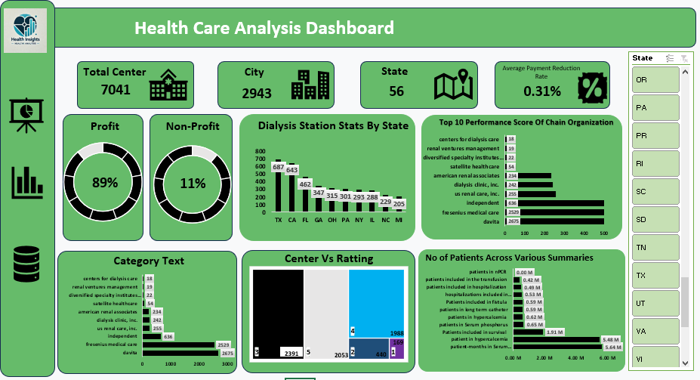
Excel dashboard

Slide 6
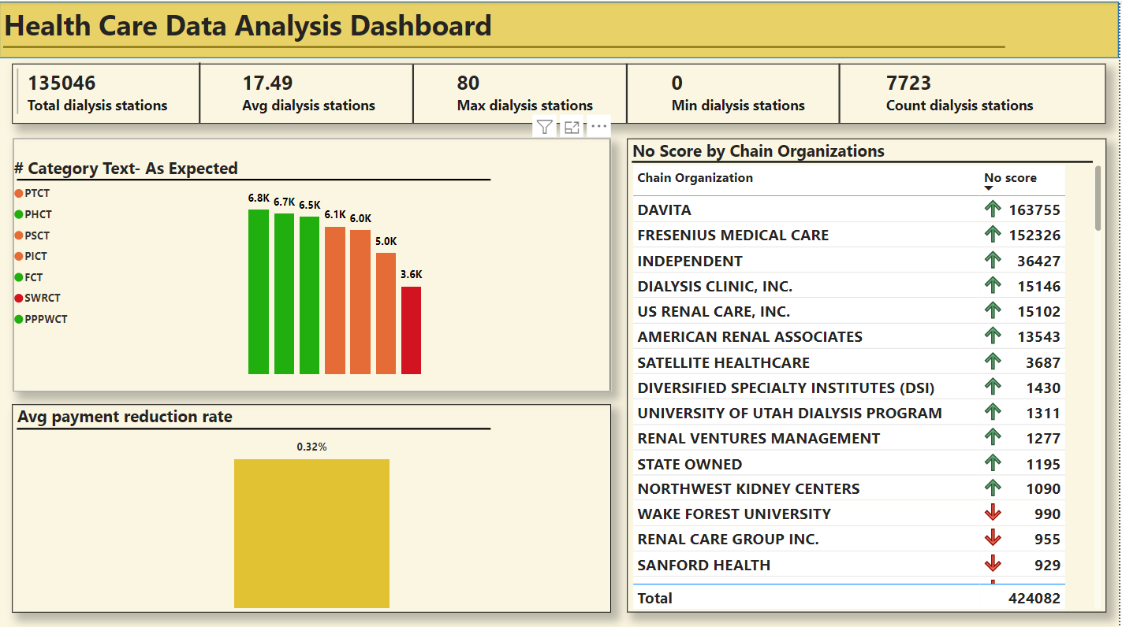
Power bi dashboard

Slide 7
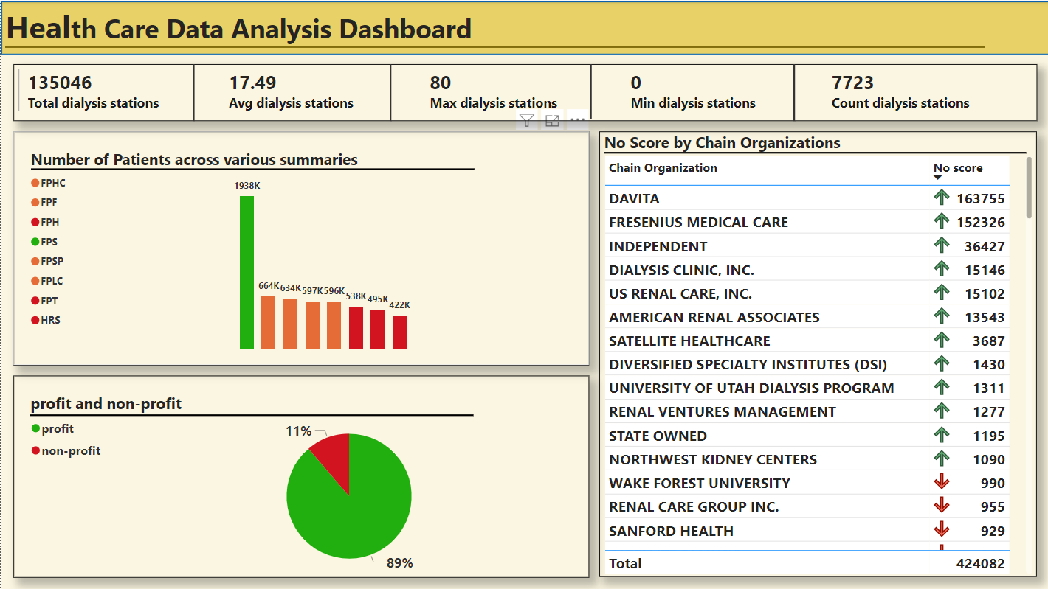
Power bi dashboard

Slide 8
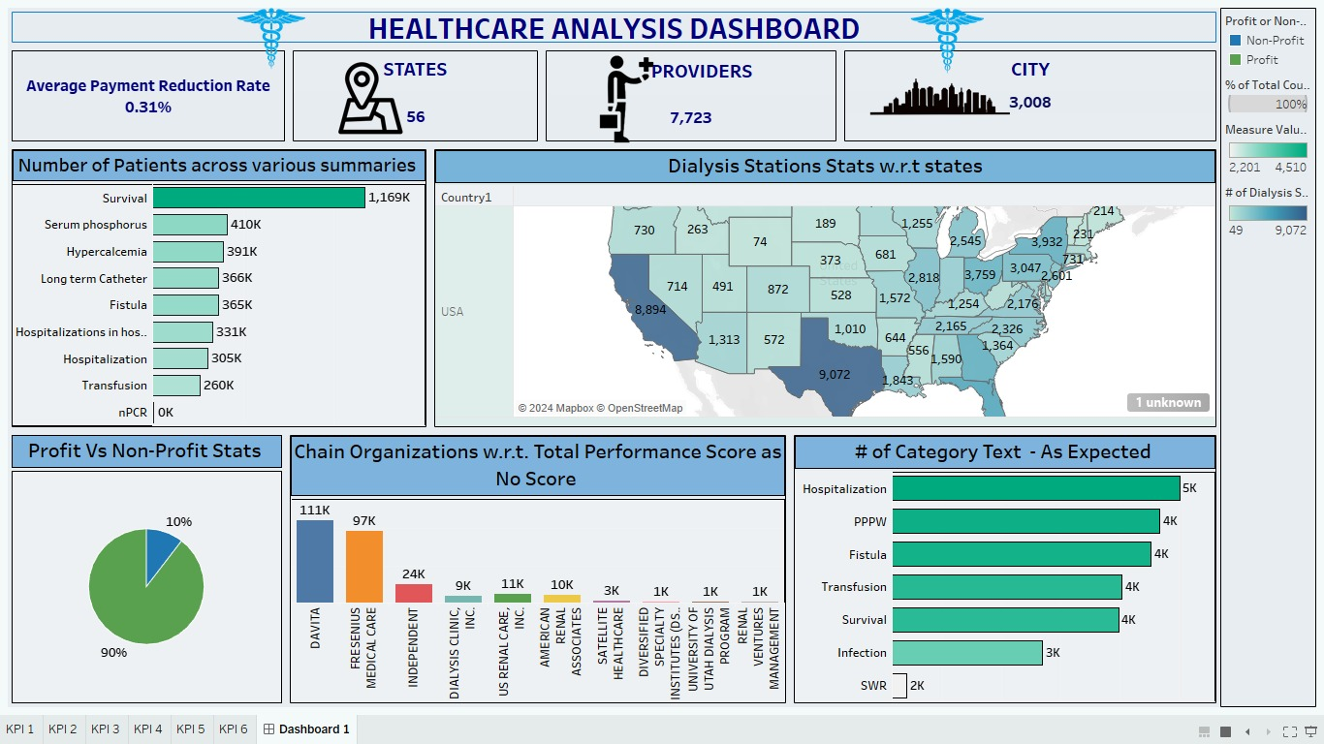
Tableau dashboard

Slide 9
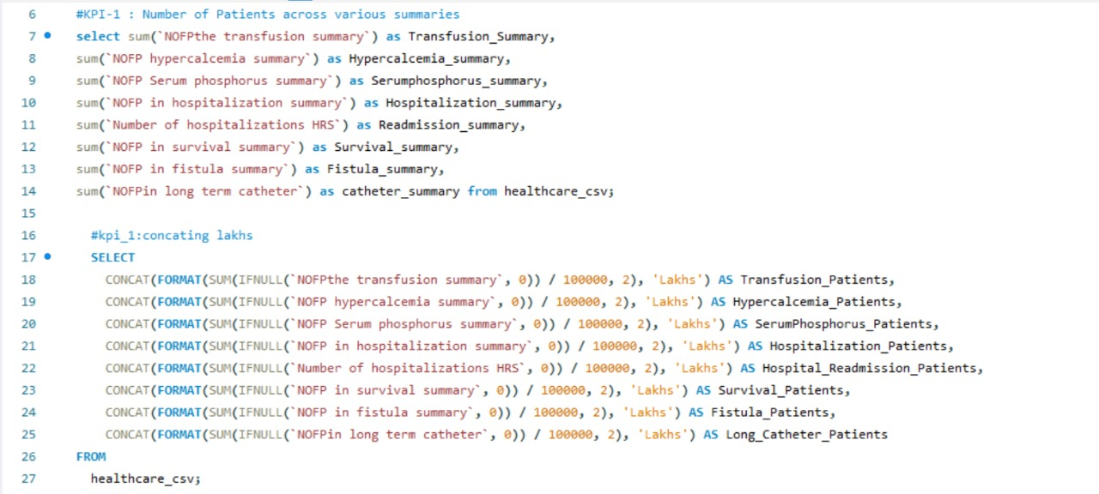
Sql Queries

Slide 10
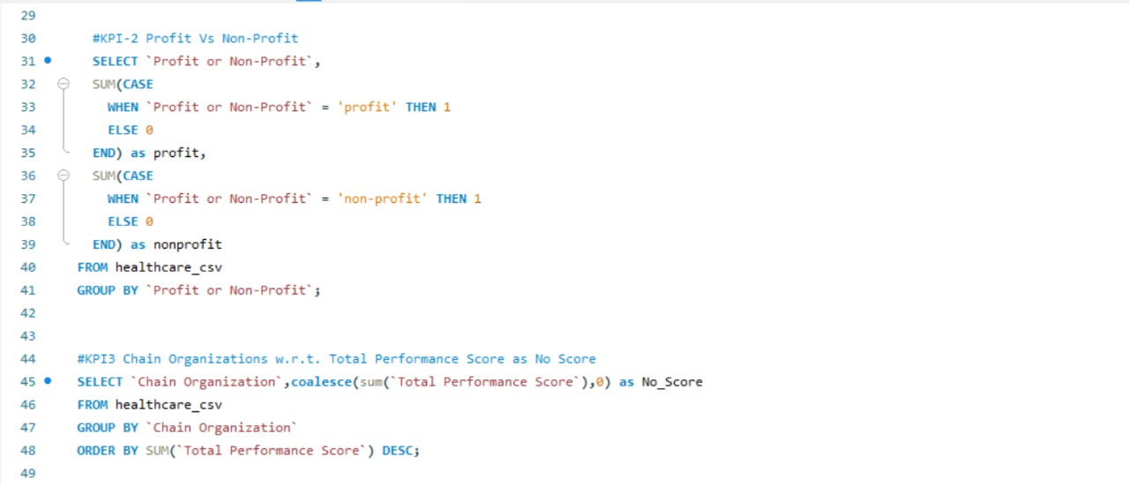
Sql Queries

Slide 11
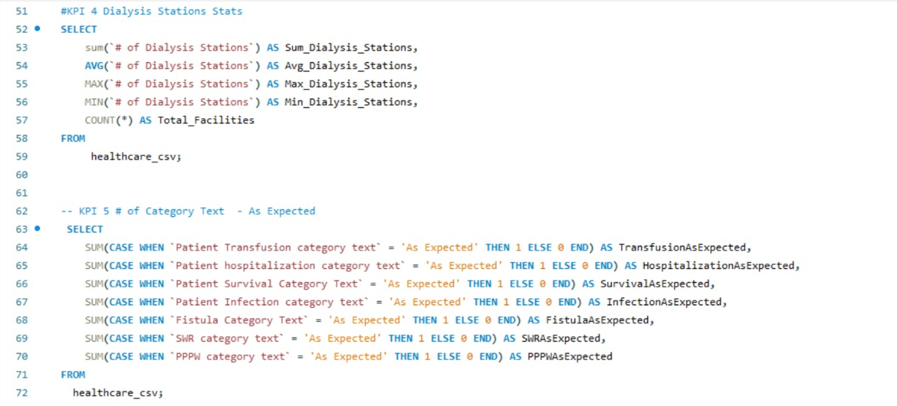
Sql Queries

Slide 12
KPI’s
Number of Patients across various summaries
Profit Vs Non-Profit Stats
Chain Organizations w.r.t. Total Performance Score as No Score
Dialysis Stations Stats
# of Category Text - As Expected
Average Payment Reduction Rate

Slide 13
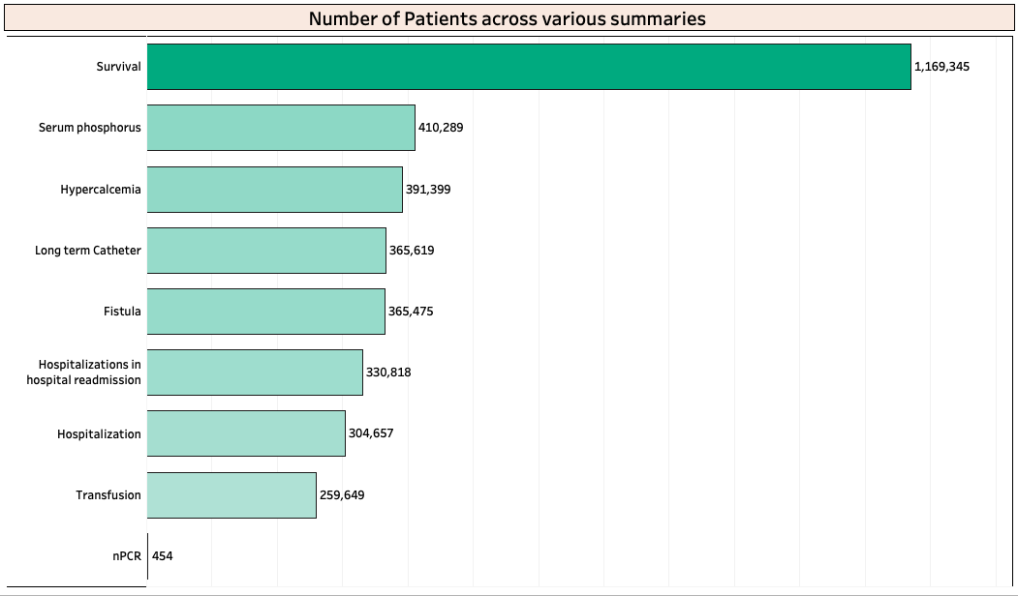
KPI’s 1 Number of Patients across various summaries
Insight:
Trend Observations: Identified a consistent increase in patient numbers in certain facilities

Slide 14
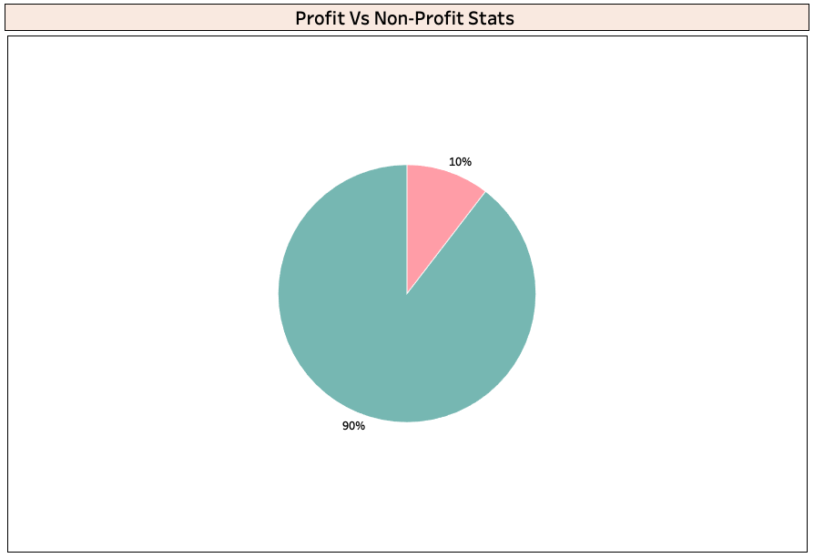
KPI’s 2 Profit Vs Non-Profit Stats
Insight:
Profit Dominance: 90% of the healthcare facilities analyzed are profit-driven, with the remaining 10% being non-profit.
Operational Efficiency: Profit facilities may have higher patient satisfaction, but the financial analysis shows non-profits often achieve lower costs, reflecting in their ability to manage resources effectively despite financial constraints.

Slide 15
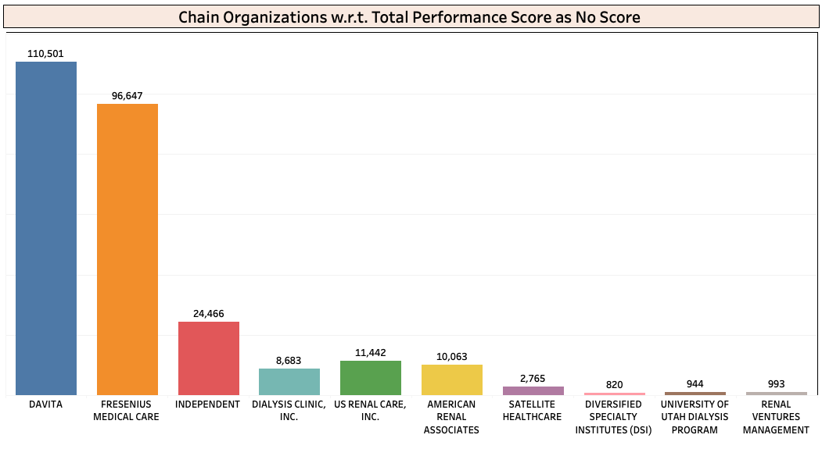
KPI’s 3 Chain Organizations w.r.t. Total Performance Score as No Score
Insight:
Performance Consistency: Chain organizations show more consistency in their Total Performance Scores, suggesting standardized processes across locations. No Score Anomalies: A notable percentage of chain facilities have no scores reported, possibly due to new acquisitions or reporting lags.

Slide 16
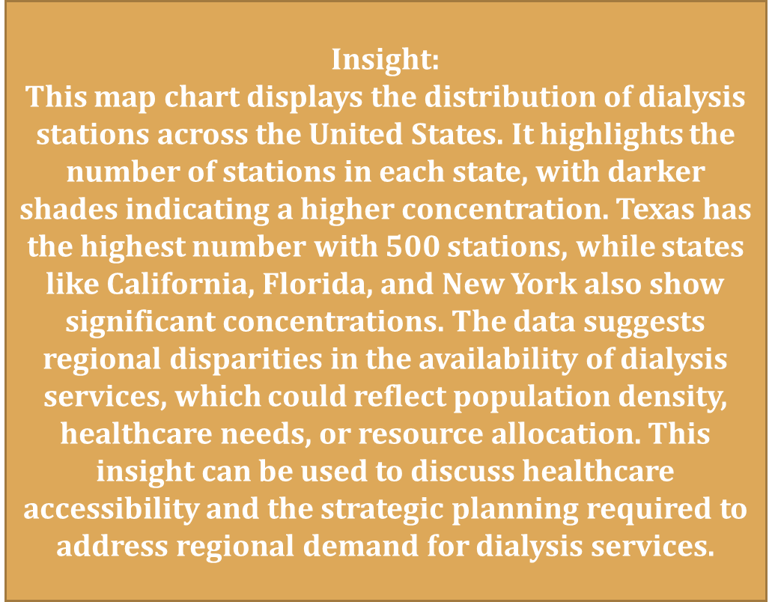
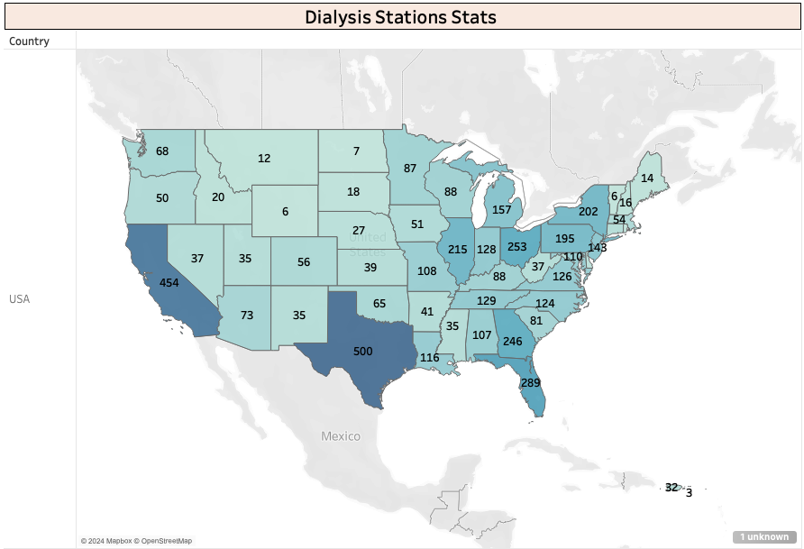
KPI’s 4 Dialysis Stations Stats

Slide 17
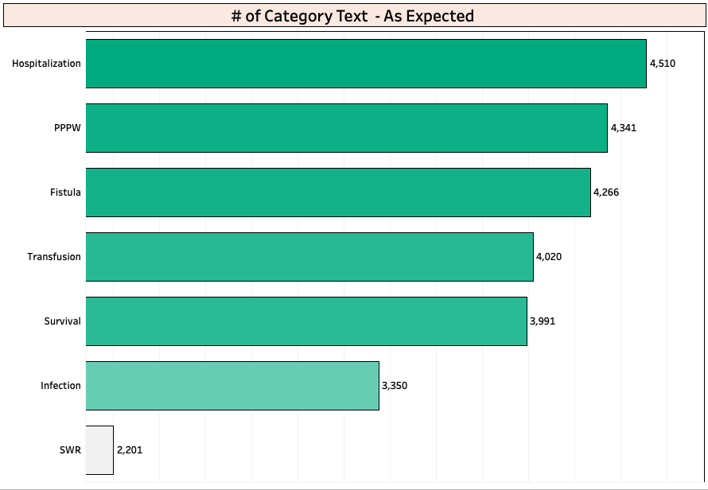
KPI’s 5 # of Category Text - As Expected
Insight:
Expectation vs. Reality: Most facilities meet the expected performance in this category, but outliers suggest areas for further investigation or improvement.

Slide 18
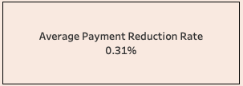
KPI’s 6 Average Payment Reduction Rate
Insight:
Cost Control Effectiveness: The average payment reduction rate across facilities is 0.31%, with higher-performing facilities achieving even lower rates, indicating superior cost management.
Financial Impact: Facilities with higher reduction rates tend to underperform, highlighting the financial challenges they face and the potential need for strategic improvements..

Slide 19
Challenges
Data Cleaning Challenges:
Encountered numerous null values in the dataset. This issue was addressed through discussions with the group, leading to an effective solution for handling the missing data.
SQL Data Loading Issues:
Faced difficulties in loading data into SQL. The team sought help from a previous project mate, which helped resolve the problem and successfully load the data.
Team Member Withdrawal:
A team member who initially accepted the work quit the group two days before the project deadline. Despite this setback, the remaining team members showcased strong teamwork and managed to complete the project within the tight timeframe of two days.

Slide 20
Conclusion
In conclusion, this healthcare diagnosis analysis project successfully identified critical areas for improvement within the healthcare system by examining a diverse set of key performance indicators. The insights gained from analyzing patient numbers, organizational performance, dialysis station efficiency, and financial metrics provide a solid foundation for driving strategic decisions. Implementing the recommendations derived from this analysis can lead to enhanced patient care, more efficient resource utilization, and better financial outcomes for both profit and non-profit healthcare organizations. This project underscores the importance of data-driven approaches in optimizing healthcare services and ensuring sustainable growth.

Slide 21
Thank you

